Slide 1
Guidance for Short Practice Meeting
The aim of this slide deck is to help Antibiotic Champions (or whomever leads antimicrobial stewardship at your practice) facilitate a practice meeting to promote the use of the three effective strategies to reduce antibiotic use.
The 8 slides contain a summary of information on the three strategies:
Discussing antibiotics & using patient leaflets interactively
Point-of-care CRP testing
Using back-up/delayed prescriptions
Suggestions for use:
Familiarise yourself with this slide deck
Familiarise yourself with https://antibioticoptimisation.web.ox.ac.uk/
Insert data on antibiotic prescribing rates in your practice on slide 3 if needed
Read the notes on each slide as these contain detailed actions to help promote each strategy
Email the slides to all practice staff after the meeting & discuss them with those who couldn’t attend

Slide 2
Objectives Introduce the Antibiotic Optimisation online resources (https://antibioticoptimisation.web.ox.ac.uk/) Introduce three strategies to optimise antibiotic use: 1. Tips on discussing antibiotics and using patient leaflet interactively 2. Using point-of-care C-Reactive Protein (POC CRP) tests 3. Using back-up/delayed antibiotic prescriptions Discuss the strategies and agree how you are going to use them in this practice
Practice meeting
V1 Oct 2019

Slide 3
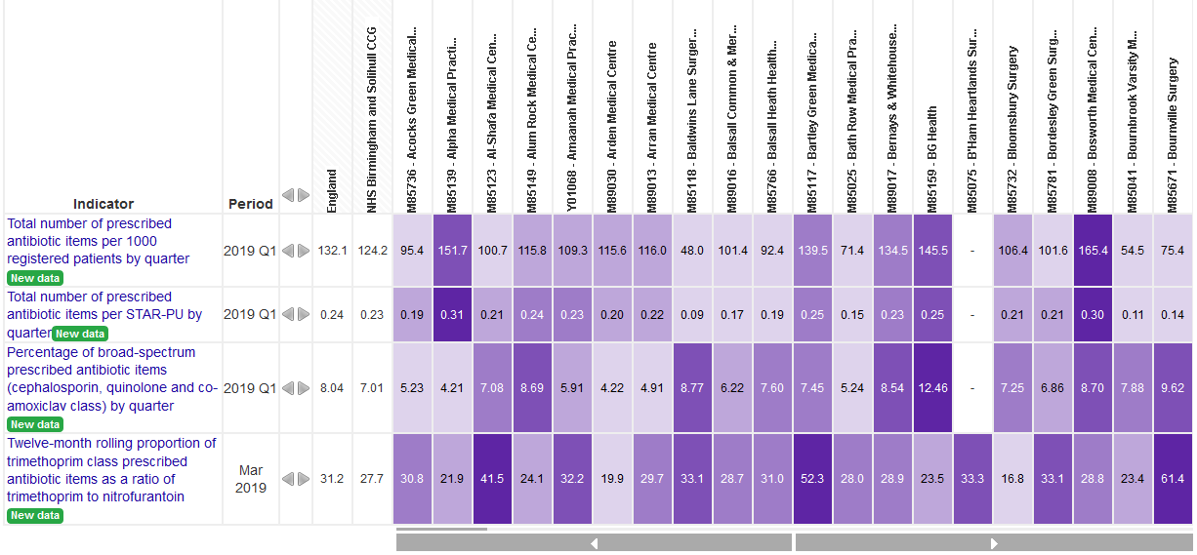
Why use strategies to optimise antibiotic use?
NOTE TO CHAMPION: Replace these graphs with graphs for your practice – see in Comments below how to access the data
Antibiotic prescribing in this practice
Volume of antibiotics over time
Compared nationally & to other practices
Darker colour = higher quintile of antibiotic prescribing
Notes:
The left graph is from the OpenPrescribing website which shows antibiotic prescribing rates in your practice over time.
Find your practice here: https://openprescribing.net/practice/.
Then select ‘Antimicrobial Stewardship’ measures.
The right graph is from the Fingertips website which shows how your practice’s antibiotic prescribing compares nationally in the latest quarter.
Go to: https://fingertips.phe.org.uk/profile/amr-local-indicators/data#page/0/gid/1938133070/pat/152/par/E38000001/ati/7/are/B83620.
Select ‘Antibiotic Prescribing’ in the top bar.
Then in ‘Area type’ select ‘GP’; in ‘Areas grouped by‘ select ‘CCGs (2018/19)’; in ‘CCGs (2018/19)’ select your CCG.
Your practice should be listed in the data table below. You can order practices alphabetically or in order of prescribing rates.

Slide 4
Strategy 1a – Finding the right words to discuss antibiotics
Why? Increase patient satisfaction & understanding of prescribing decisions; reduce consultations; reduce antibiotic prescribing
How? Key elements of effective consultations (CHESTSSS)
Read more on Antibiotic Optimisation website
NOTE TO CHAMPION: You may want to highlight examples for timeline, shortcoming and self-care. If not, then delete the stars
T
S
S
Notes:
ACTIONS for Antibiotic Champion
1. Provide all prescribers with a copy of the “Top tips for discussing antibiotics” handout.
2. Encourage prescribers to read more examples of things to say to patients provided on www.antibioticoptimisation.web.ox.a.cuk

Slide 5
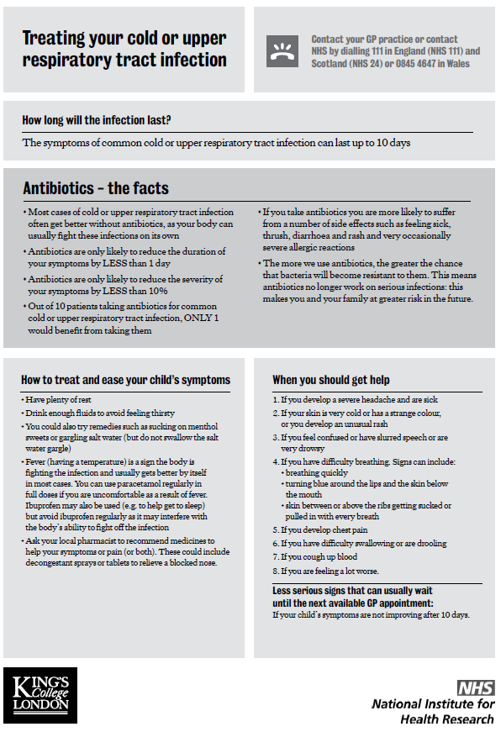
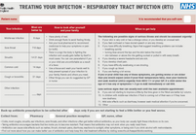
Strategy 1b – Discussing a leaflet interactively in your consultations
WHY? Address patient concerns; empower patients to self-manage; maintain patient satisfaction; standardise advice given by different prescribers; provides additional support to verbal advice
HOW? Discuss throughout consultation & personalise by drawing attention to parts relevant to the patient.
Treating Your Infection
RTIs & UTIs
24 languages & pictorial version
A4
When Should I Worry?
Children with RTIs
A6 booklet
Caring for Coughs
Adults
A6 booklet
RTI Infosheets
Adults & children
Infection-specific
A4
Download leaflets from Antibiotic Optimisation website
Notes:
ACTIONS for Antibiotic Champion
Ensure that copies of patient leaflets and booklets are available in all consulting rooms.
You can upload the leaflets on your clinical system (instructions are available on the TARGET toolkit) or save the pdfs on computer desktops.

Slide 6
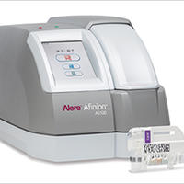
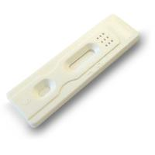
Strategy 2 – Using POC CRP testing
WHY? Useful in cases of clinical uncertainty to help differentiate a serious from self-limiting respiratory infection (NICE Guidelines (CG191)); evidence shows it safely reduces antibiotic prescribing; relatively quick & easy; benchmarks your ‘gut feeling’
HOW? Two types of tests are available as part of the study, giving you more flexibility
 | Afinion | SureScreen
CRP reading | Numeric result in range: 5 to over 200 | Result as a line for CRP levels over: 10, 40 or 80
Time for the result | 3-4 minutes | 5 min (do not interpret the result after 8 minutes)
Practicalities | Cartridges need to be removed from the fridge at least 15 min before use or can be stored at room temp for 4 weeks. They need to be used within 10 min after opening the foil pouch. | Tests can be stored at room temp until expiration date printed on the pouch. The test must remain in the sealed pouch until use. Tests are portable.
For instructions on how to use and interpret each test see Antibiotic Optimisation website
Notes:
ACTIONS for Antibiotic Champion
Ensure all staff using the analyser are trained in using it and have the required competencies (as advised by the Abbott team).
Print a SUMMARY SHEET FOR INTERPRETING CRP TEST RESULTS (on the website) and display it in suitable places (e.g., near the Afinion analyser, in consultation rooms).
Ensure all prescribers complete the TRAINING TASK: use each type of the test on 5 patients presenting with RTIs and record the results of the Afinion test on the SHEET FOR RECORDING CRP TEST RESULTS - print it and display it next to the Afinion analyser.
Set a procedure for, and ensure that, the Afinion analyser is switched on and set up every day (see online training videos (modules 2 and 3)).
Ensure that the quality control tests on the Afinion analyser are conducted as advised by the Abbott team.

Slide 7
Strategy 2 – Using POC CRP testing
Training task
Afinion | SureScreen
Each prescriber to carry out a CRP test on 5 patients presenting with acute cough using the Afinion analyser. Record the CRP results on the summary sheet | Each prescriber to carry out a CRP test on 5 patients presenting with acute cough using the SureScreen CRP test.
Record Afinion CRP results on summary sheet next to the analyser.

Slide 8
Strategy 3 – Using back-up/delayed prescriptions
WHY? Useful in case of uncertainty whether immediate antibiotic is needed at that point; helps reduce re-consultations, prevent complications, reduce patient use of antibiotics, increase patient’s ability to self-manage infections
How to explain? Patients are likely to better understand and accept a back-up/delayed antibiotic prescription if you incorporate two additional key points into CHESTSSS
5 ways to issue:
Give a prescription with advice to get it dispensed only if needed
Ask patient to collect the prescription from an agreed location
Write a post-dated prescription
Ask patient to contact the practice again to get the prescription
Ask patient to collect antibiotic now but only use if needed.
How to record? Type “deferred antibiotic” or use the relevant READ/SNOMED codes
READ (8BP0 - deferred antibiotic therapy; 8CAk - patient advised to delay filling of prescription)
SNOMED (XxKYH - deferred antibiotic therapy)
1. Reasons for giving it
Reassure patient that there is no need for an immediate antibiotic prescription; acknowledge that it is not possible to predict exactly how the illness will progress; and that you would like the patient to have access to antibiotics should their symptoms get worse or not improve as expected.
2. Specify no. of days to wait
Tailor advice to patient’s current experience of infection, prior duration & expected natural history, co-morbidities, & their ability to timely access antibiotics
Read more on Antibiotic Optimisation website
Notes:
ACTIONS for Antibiotic Champion
Ensure printed copies of the REMINDER SHEET FOR BACK-UP/DELAYED ANTIBIOTIC PRESCRIPTIONS are available in all consulting rooms.
Ensure codes for back-up/delayed antibiotic prescriptions are set-up and available on the clinical system.
Encourage prescribers to code back-up/delayed prescriptions and tick the relevant section on TYI leaflets for patients.

Slide 9
Next steps
Which examples from the “Top Tips” do we not already cover in your consultations? Which examples will we now use? E.g. discuss illness Timeline.
Which leaflet(s) shall we use in the practice? Will we use the provided hard copies, print leaflets in consultations, or text/email links to patients?
In which scenarios shall we use POC CRP tests in our practice?
Which type of POC CRP are we going to use in our practice? Afinion/SureScreen/both?
In which scenarios shall we use back-up/delayed prescriptions in our practice?
Which formats of back-up/delayed prescriptions will we use as a practice? Which as individuals?
Notes:
ACTION for Antibiotic Champion
1. Arrange a meeting to review the use of the three strategies in 2-3 months.

