Slide 1
Guidance for Practice Meeting on Discussing Antibiotics
The aim of this slide deck is to help Antibiotic Champions (or whomever leads antimicrobial stewardship at your practice) facilitate a practice meeting to review ‘finding the right words to discuss antibiotics’ with patients.
The slides contain a summary of information about this strategy:
Why and how to use this approach to discussing antibiotics
Why and how to use leaflets in consultations
Suggestions for use:
Familiarise yourself with this slide deck
Familiarise yourself with https://antibioticoptimisation.web.ox.ac.uk/
Email the slides to all practice staff after the meeting & discuss them with those who couldn’t attend

Slide 2
Tips on finding the right words to discuss antibiotics and using patient leaflets interactively Antibiotic Optimisation online resources (https://antibioticoptimisation.web.ox.ac.uk/)
Practice meeting
V1 Oct 2019

Slide 3
Finding the right words to discuss antibiotics
WHY?
Evidence shows that effective communication skills:
Increase patient satisfaction & understanding of prescribing decisions
Reduce consultations
Reduce antibiotic prescribing
They are particularly helpful for patients expecting antibiotics (when antibiotics aren’t indicated)
Are easy and quick (involve tweaking or adding short sentences to your usual patter)
Can be used in all consultations

Slide 4
Finding the right words to discuss antibiotics
HOW? Key elements of effective consultations (CHESTSSS)
More examples are on Antibiotic Optimisation website

Slide 5
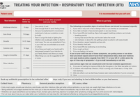
Finding the right words to discuss antibiotics
Consider in particular:
Be specific about illness TIMELINE / usual course
Set realistic expectations of when patients are likely to feel better.
‘Treating your infections – RTI’ leaflet provides these durations
Infection | Average duration
Sore throat | 7-8 days
Middle ear infection | 8 days
Common cold | 14 days
Sinusitis | 14-21 days
Cough, bronchitis | 21 days
Explain SHORTCOMINGS & limited benefit of antibiotics, e.g.:
‘Cough usually lasts about 3 weeks and antibiotics may only reduce it by 1 day.’
‘Patients taking antibiotics are more likely to develop bacterial resistance to that antibiotic.’
‘Up to 1 in 10 people taking antibiotics experience side effects, e.g. diarrhoea, nausea, rash.’
Advise on specific things patients can do to SELF-CARE, e.g.:
Rather than giving general advice ‘rest and drink more water’, be more specific, e.g. ‘take regular paracetamol four times a day to ease the pain’.

Slide 6
Discussing a leaflet interactively
WHY?
Using a patient leaflet interactively in consultations:
Is the best way to support your verbal advice & help patients remember it
Addresses patient concerns
Empowers patients to self-manage
Improves patient recall
Improves patient satisfaction
Standardises advice given by different prescribers

Slide 7
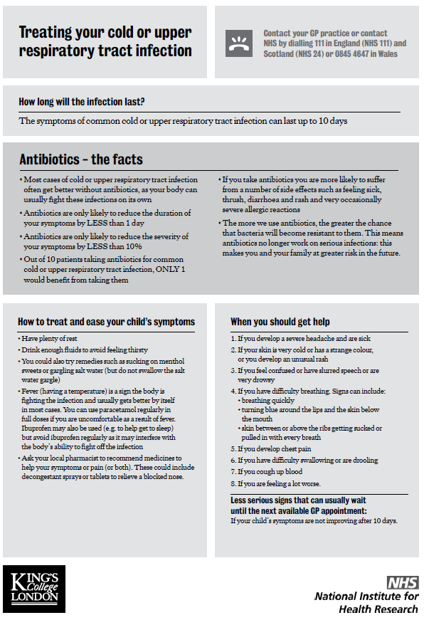
Discussing a leaflet interactively
HOW?
Use patient leaflets interactively - discuss & personalise leaflet by drawing attention to the parts relevant to the patient
Treating Your Infection
RTIs and UTIs
24 languages & pictorial version
A4
When Should I Worry?
Children with RTIs
A6 booklet
Caring for Coughs
Adults
A6 booklet
RTI Infosheets
Adults & children
Infection-specific
A4
Download leaflets from Antibiotic Optimisation website

Slide 8
Review
Which examples from the “Top Tips” have you tried in your consultations? How did it go? How do patients respond?
Have you got examples of other helpful things to say as part of CHESTSSS?
How can you further improve how you discuss antibiotics with patients?
Which leaflets have you used? How helpful were they?
Have you used the leaflets interactively in consultations?
How have you given the leaflets? E.g. hard copies, text/email link to patients?

